Slide 1



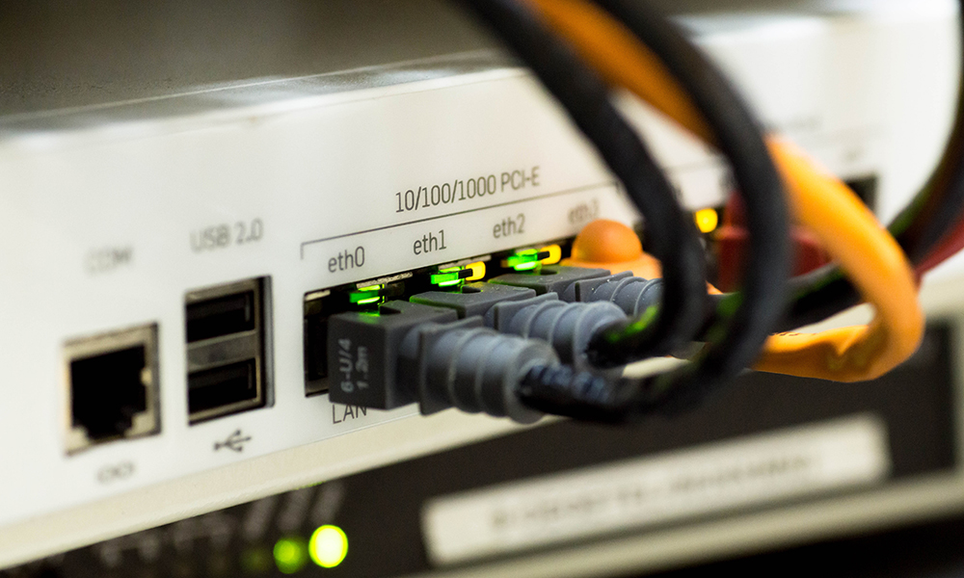

CSC 1010 Networks & Internet
Dr. Mohammed Amine TOGOU
Network Models
1

Slide 2



Learning outcomes
• Enumerate the layers of the OSI and TCP/IP models and explain what each layer does
• Give examples of protocols used in each layer
• Describe the concept of data encapsulation
2
CSC 1010: Networks & Internet | Network Models

Slide 3
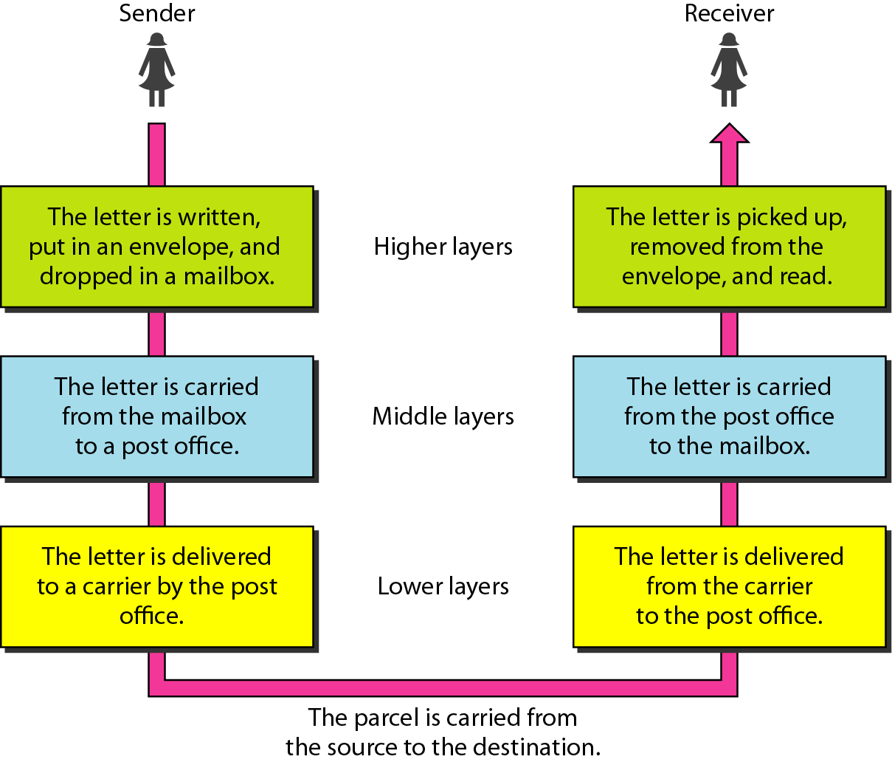
Layered communication
We use the concept of layers in our daily life, e.g., corresponding through postal mail.
3 actors: a sender, a receiver, and a carrier that transports the letter.
There is a hierarchy of tasks.
Each layer at the sending site uses the services of the layer immediately below it.
The lowest layer uses the services of the carrier.
3
CSC1010: Networks & Internet | Network models

Slide 4

Layered communication
In networking, we have something similar
We call this setup a layered communication
The bottom layer is the 0’s and 1’s
The top layer is the available services
And there are many layers in-between
4
CSC1010: Networks & Internet | Network models

Slide 5

Network communication models
There are two main communication models that you need to know:
Open Systems Interconnections (OSI)
TCP/IP
5
CSC1010: Networks & Internet | Network models

Slide 6
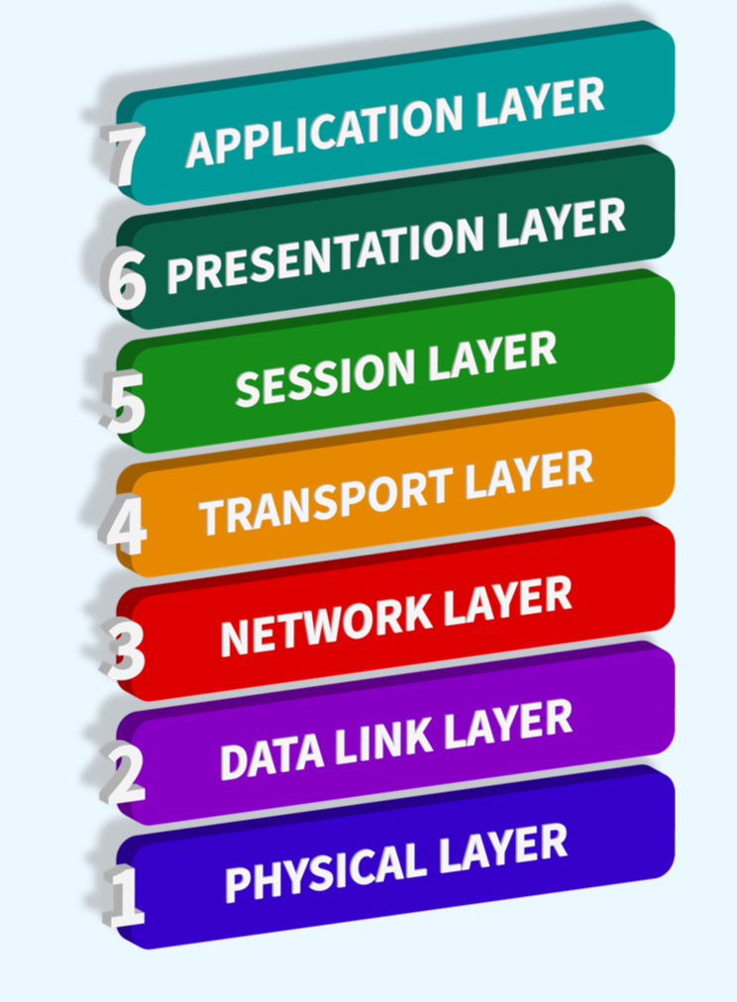
OSI model
It’s theoretical
It’s a blueprint on how to build a network architecture from scratch
It has 7 layers
It defines the services provided by each layer
6
CSC1010: Networks & Internet | Network models

Slide 7
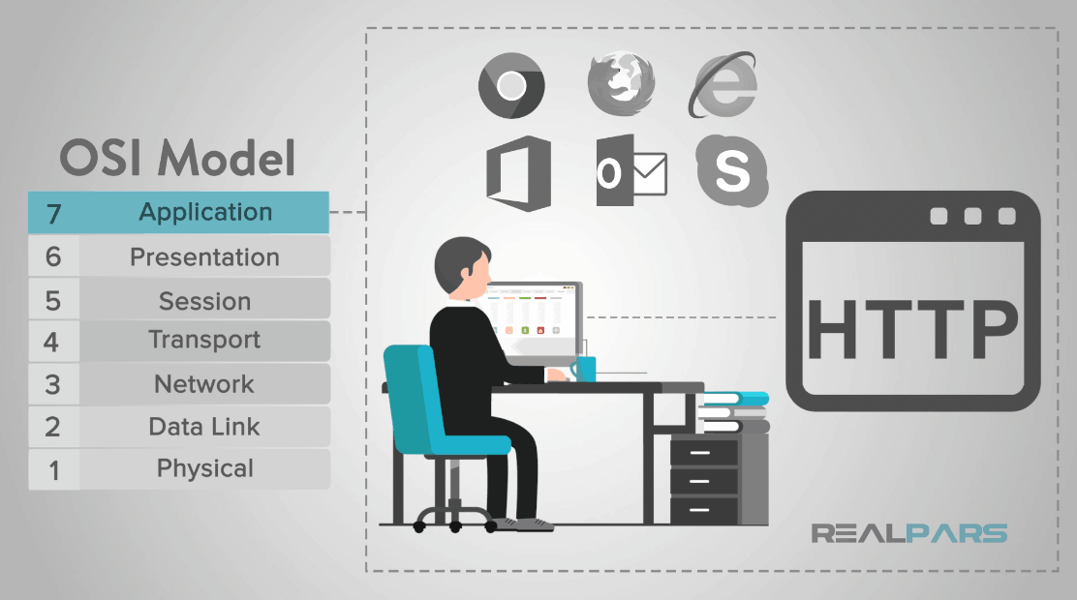
Application layer
This layer represents the services that directly support applications that use the web: chrome, mobile apps, etc.
It represents the level at which these applications access network services
7
CSC1010: Networks & Internet | Network models

Slide 8
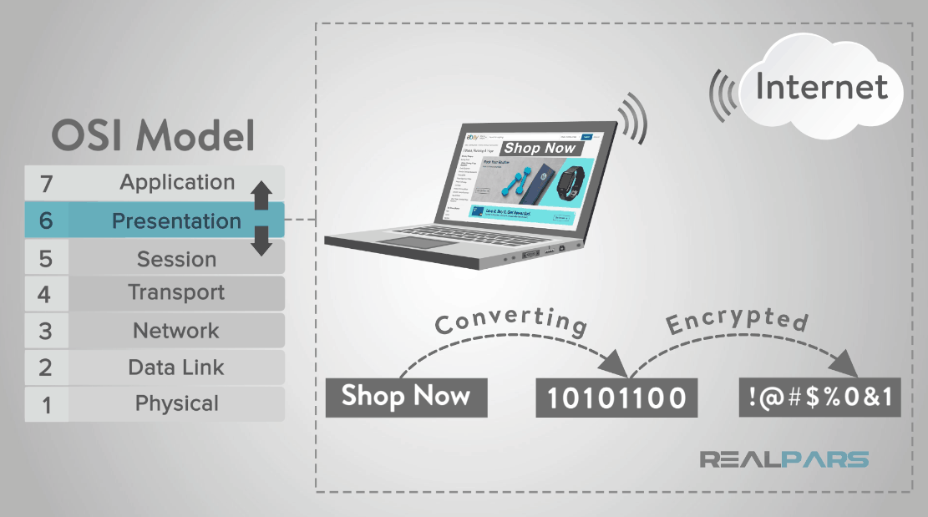
Presentation layer
It translates data from the Application layer into an intermediary format
It manages security issues by providing services such as data encryption
It compresses data so that fewer bits need to be transferred on the network
8
CSC1010: Networks & Internet | Network models

Slide 9
Session layer
It allows two applications on different computers to establish, use, and end a session
It establishes dialog control between the two computers in a session
It regulates which side should transmit, plus when and how long it can transmit
9
CSC1010: Networks & Internet | Network models

Slide 10
Transport layer
It handles error recognition and recovery for end-to-end communications
It repackages long messages, when necessary, into small parts for transmission
It assembles these parts into the original message at the receiving end
It confirms the receipt of the data through acknowledgments
10
CSC1010: Networks & Internet | Network models

Slide 11
Network layer
It determines the route from the source to the destination
It manages traffic problems, such as switching, routing, and controlling the congestion of data packets
11
CSC1010: Networks & Internet | Network models

Slide 12
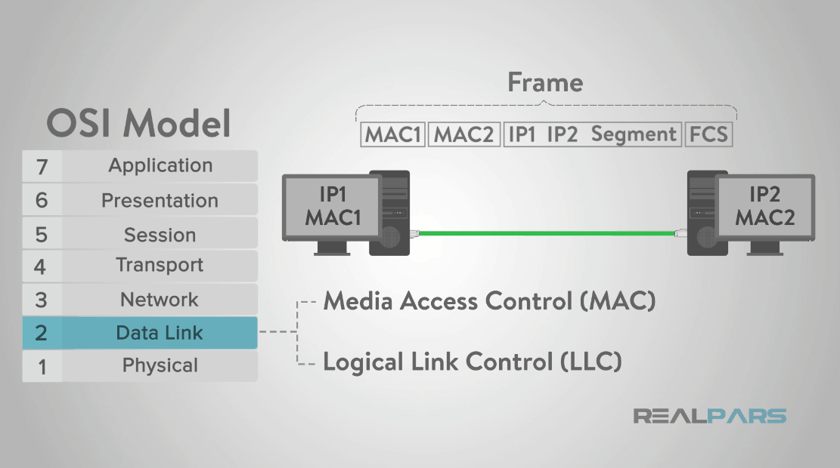
Data link layer
It packages data from the Network Layer into frames
It transfers frames from one device to another without errors
It waits for an acknowledgment, after sending a frame, from the receiving device
12
CSC1010: Networks & Internet | Network models

Slide 13
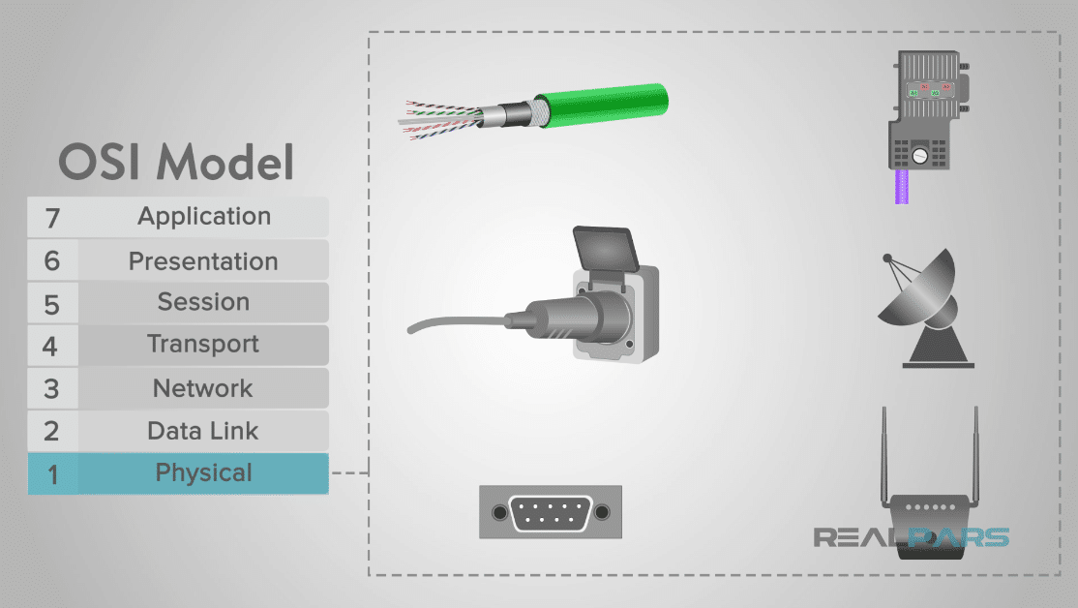
Physical layer
It transmits bits (0s and 1s) from one device to another
It defines how the cable is attached to the network adapter
It specifies what transmission technique is used to send data over the cable
13
CSC1010: Networks & Internet | Network models

Slide 14
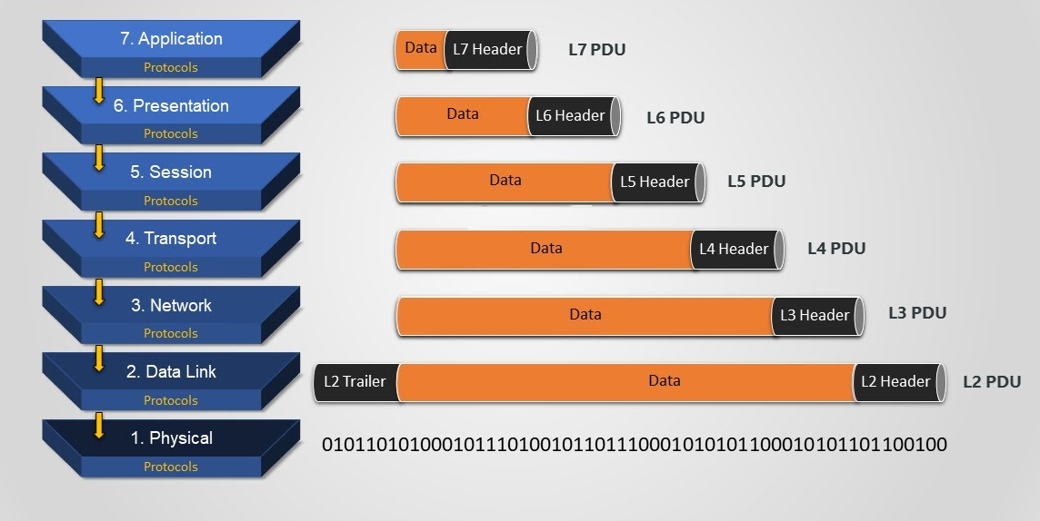
Data encapsulation/de-encapsulation
Each layer adds control information (header) to the user data and pass it to the layer below it
The data link layer adds a header and a trailer
Trailers are added at the end of the user data to check for errors
At the destination, each layer will remove the header added by the corresponding layer at the source and pass it to the layer above it
14
CSC1010: Networks & Internet | Network models

Slide 15
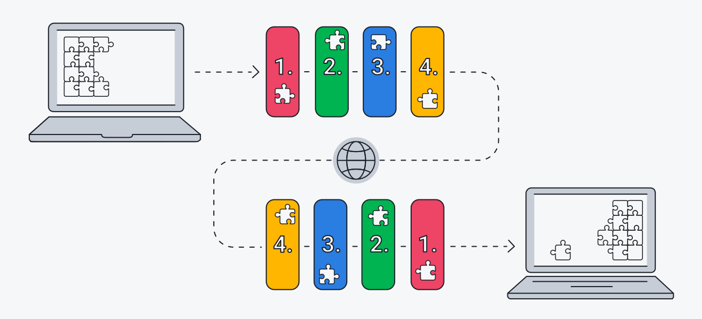
TCP/IP model
The practical version of the OSI model
It is the main communication infrastructure supporting the Internet
It has 4 layers
Few layers in TCP/IP model can provide the services of multiple layers of the OSI model
The name is derived from 2 main protocols: TCP and IP
15
CSC1010: Networks & Internet | Network models

Slide 16
OSI vs. TCP/IP
OSI
TCP/IP
Application
Application
Presentation
Session
Transport
Transport
Network
Internet
Data Link
Network
Access
Physical
16
CSC1010: Networks & Internet | Network models

Slide 17

TCP/IP model
Protocol Suite
Application
DHCP
DNS
HTTP
This is not an exhaustive list. The Application, Internet and Network Access Layers have other protocols.
Transport
TCP
UDP
Internet
IP
Network Access
Ethernet
802.11
17
CSC1010: Networks & Internet | Network models

Slide 18
Protocols
Protocols dictate how machines communicate
They control
Data format
Data content
Timing/synchronisation of communication
How the communication is managed
Think of them as a language for machines
They provide a common way for devices to understand each other
18
CSC1010: Networks & Internet | Network models

Slide 19
TCP/IP data encapsulation
User data
PDU
Application
HTTP header
User data
Segment/ Datagram
Transport
TCP or UDP header
App layer header
User data
Packet
Internet
IP header
Transp layer header
App layer header
User data
Frame
Network Access
Ethernet header
IP header
Transp layer header
App layer header
User data
Ethernet trailer
010011011110011100000011001110100101101110111
19
CSC1010: Networks & Internet | Network models

Slide 20
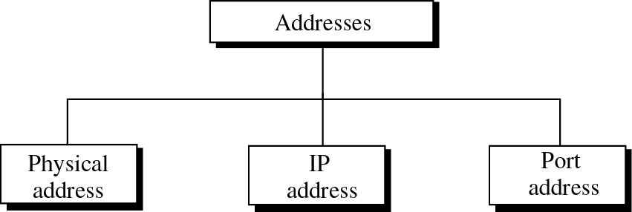
Addressing
Three different levels of addresses are used in the TCP/IP model
MAC (Media Access Control) addressing at the Network Access layer
IP addressing at the Internet Layer
Port addressing at the Transport Layer
20
CSC1010: Networks & Internet | Network models

Slide 21
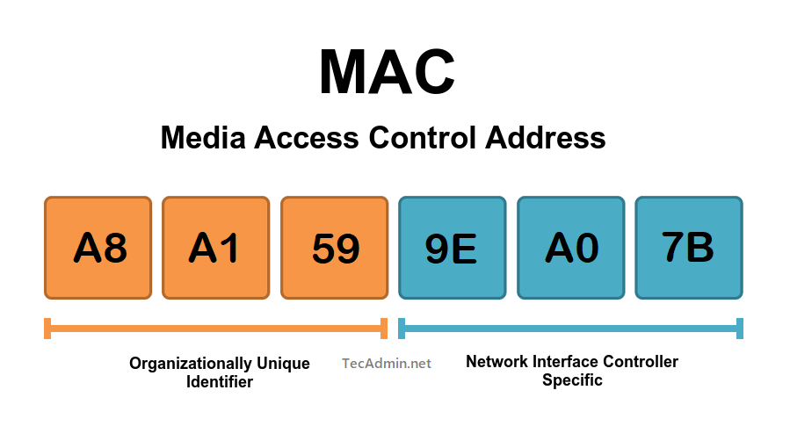
MAC address
It is used by the Network Access Layer
The address of the network interface card (NIC) used by device
It is called physical because each NIC has a unique MAC imprinted on it that can never change
Ethernet uses a 6-bytes (48 bits) MAC address
21
CSC1010: Networks & Internet | Network models

Slide 22
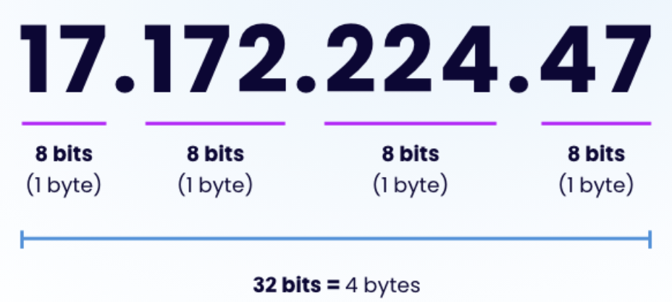
IP address
It is used by the Internet Layer
It specifies the network, and the hosts connected to it
It is called a logical address because it’s not permanent
No two devices connected to the network/Internet can have the same IP address
It is either 32 or 128 bits long, depending on the Internet Protocol version used
22
CSC1010: Networks & Internet | Network models

Slide 23
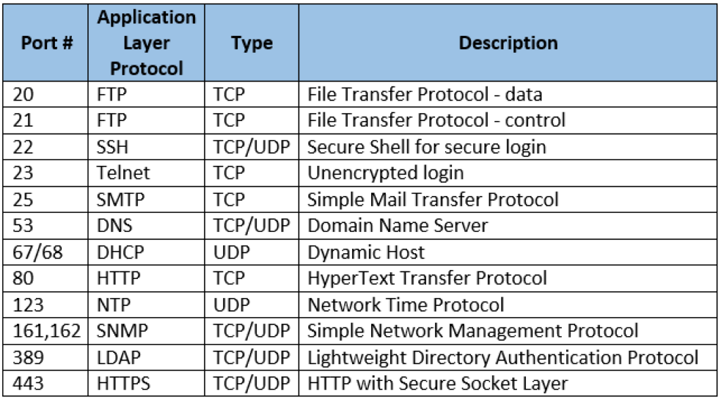
Port address
It is used at the Transport Layer
It identifies processes at the application layer
It is used to know to which process should the data message be delivered to
It is either 2 bytes (16 bits) long
23
CSC1010: Networks & Internet | Network models

Slide 24

THANK YOU
CSC 1010: Networks & Internet | Network Models

